Slide 1
Exit Seminar
Nicole Soltis
Plant Biology Graduate Group
Kliebenstein Lab
DATE HERE

Slide 3
Outline
Introduction
eQTL
Cross-species eQTL
eQTL in Arabidopsis:Botrytis
Methods
Previous Results
Novel Results
Genome search for cis-eQTL
Localized search for cis-eQTL
trans-eQTL hotspots
Cross-species eQTL hotspots
Future Directions
Notes:
Move after intro. Outline exp design/ results sections
Draw out experimental design (col0/ coi1/ npr1 – color it!)

Slide 4
Introduction

Slide 5
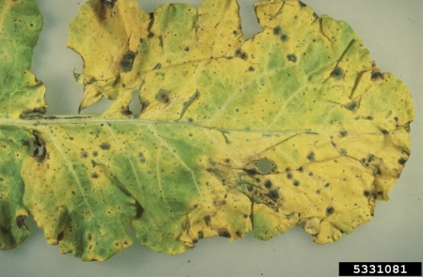
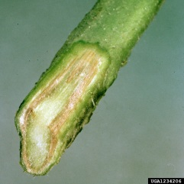
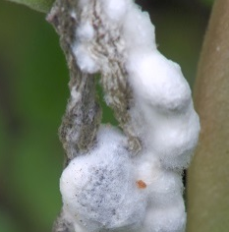
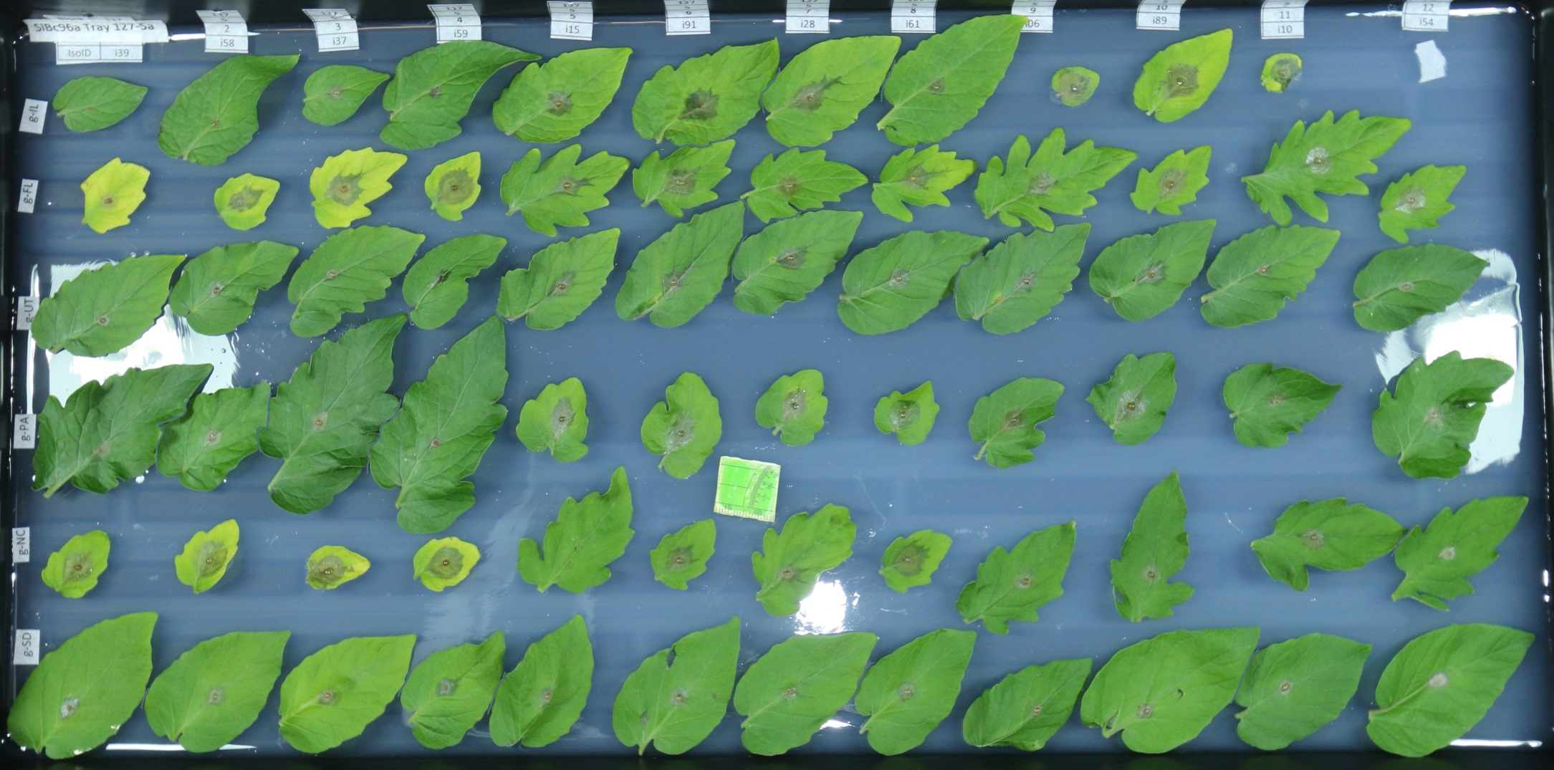
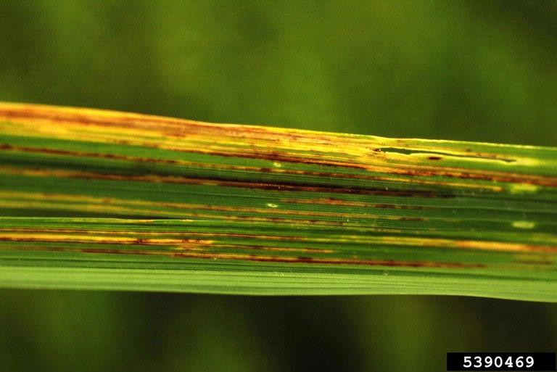
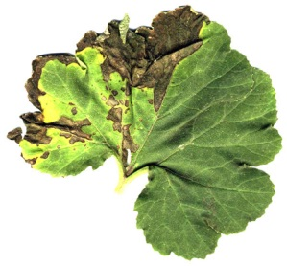
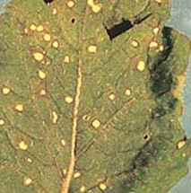
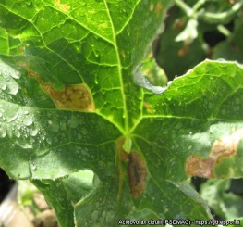
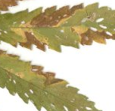
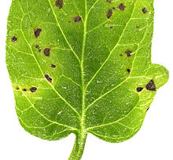
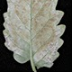
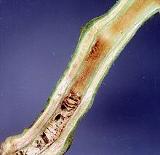
Plant Pathogens
Necrotroph
Biotroph
Specialist
Generalist
Notes:
continuum

Slide 6
Botrytis cinerea
Necrotroph
Biotroph
Specialist
Generalist
Notes:
FACT CHECK: Botrytis mostly a hemibiotroph?

Slide 7
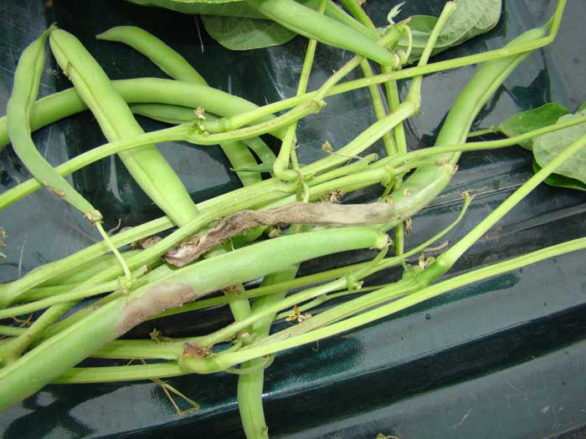
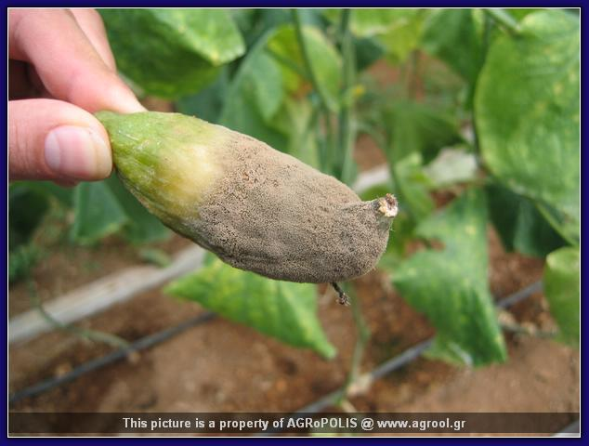
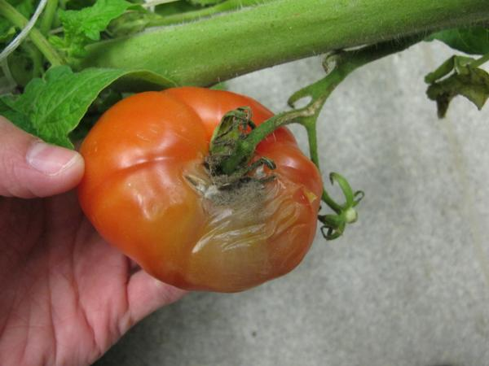
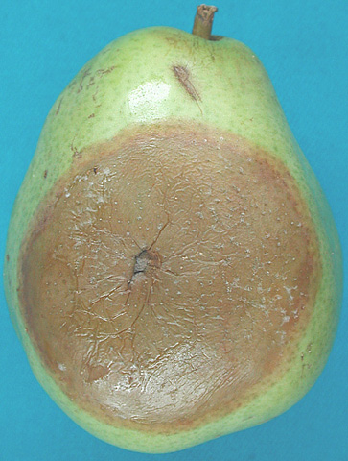
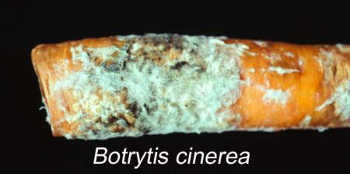
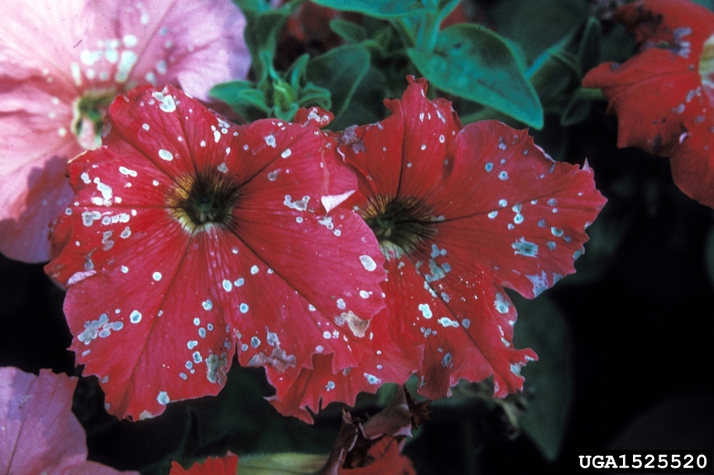
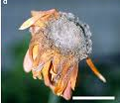
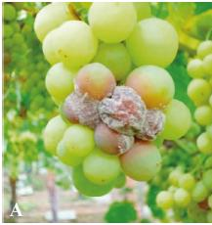
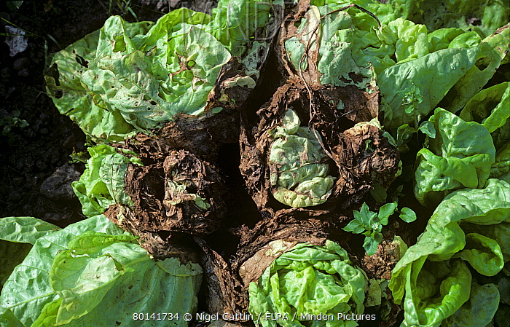
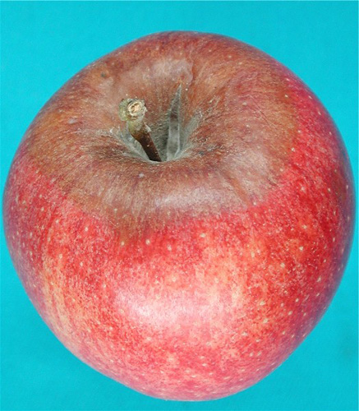
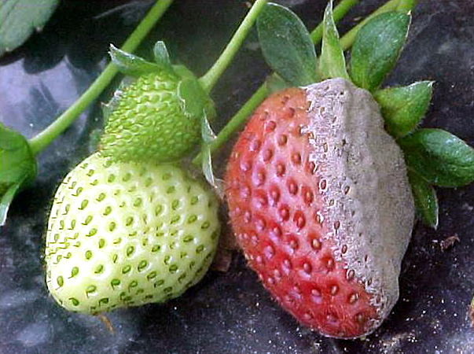
Botrytis Hosts
Notes:
Lesions on nearly all plant organs: root, leaf, stem, flowers, fruit…

Slide 8
Why do we care?
Reduce crop losses
SOME STATS HERE
Basic biology:
are there conserved plant defense networks which interact with variation in Botrytis?
What are core factors in Botrytis that contribute to virulence on specific hosts?
On many hosts?

Slide 9
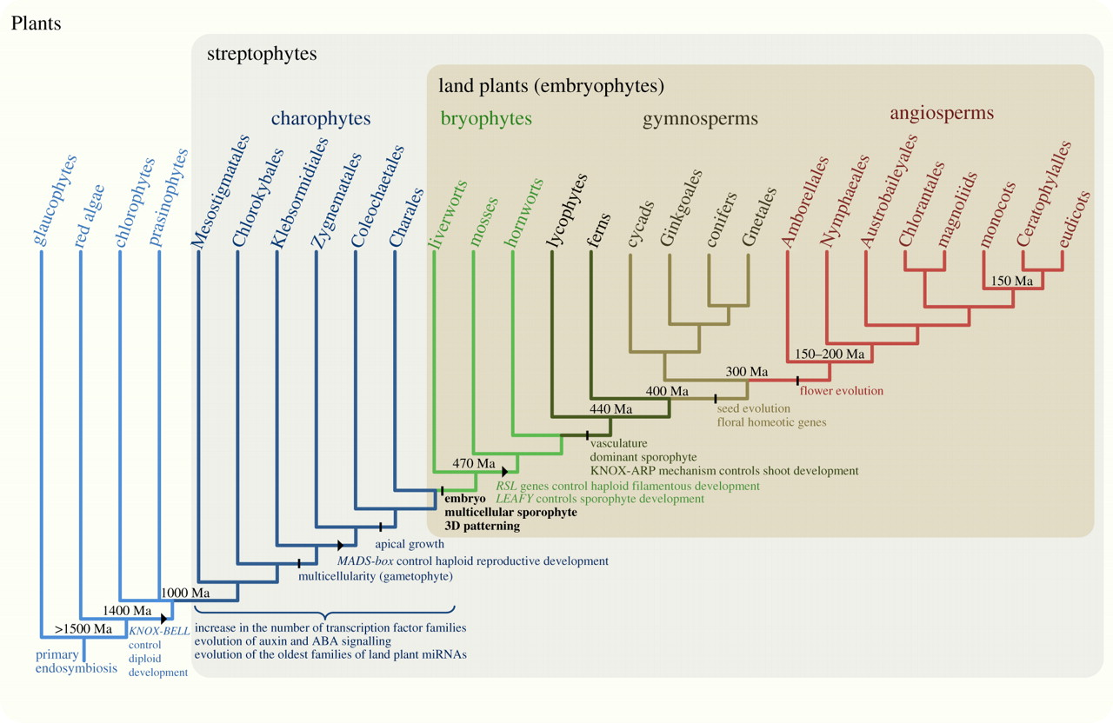

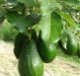


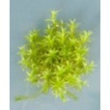

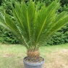

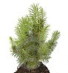
Botrytis Infects Nearly All Land Plants
Infects > 200 species
Pires et al. 2012, Royal Society
Yigal et al. 2015, Springer
Williamson et al. 2007

Slide 10
Predictions for an Extreme Generalist
“Silver Bullet” Virulence Gene
Diversity low to moderate, no specialization
Isolate Specialization
Diversity moderate to high, high population structure
Allele Specialization
High diversity, allele mixing for isolate diversity
Notes:
LITERATURE REVIEW HERE?

Slide 11
Slide to describe Botrytis quantitative virulence (genotype, phenotype)

Slide 12
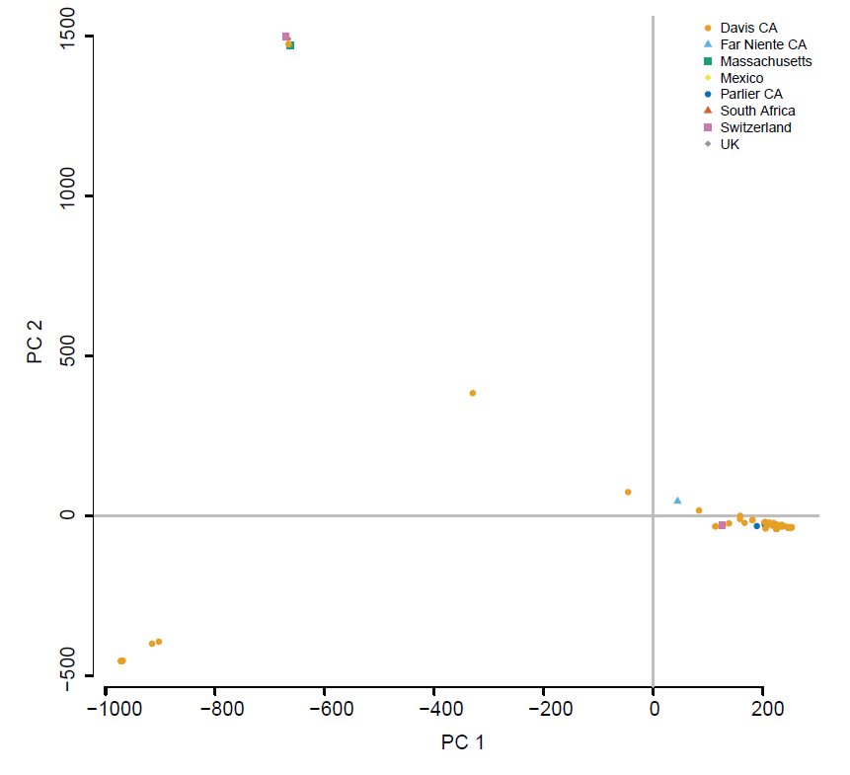
Botrytis Isolates Do Not Appear Host-Specialized
Atwell et al. in prep

Slide 13
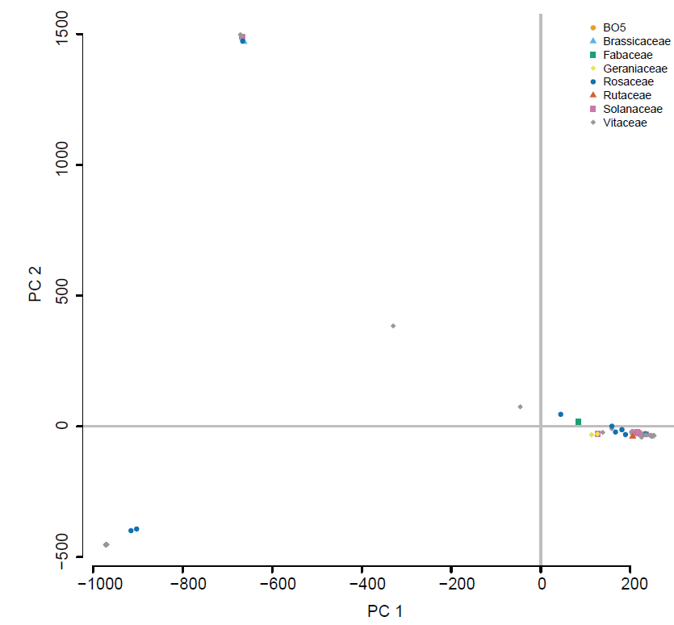
Botrytis Isolates Do Not Appear Geographically Distinct
Atwell et al. in prep

Slide 14
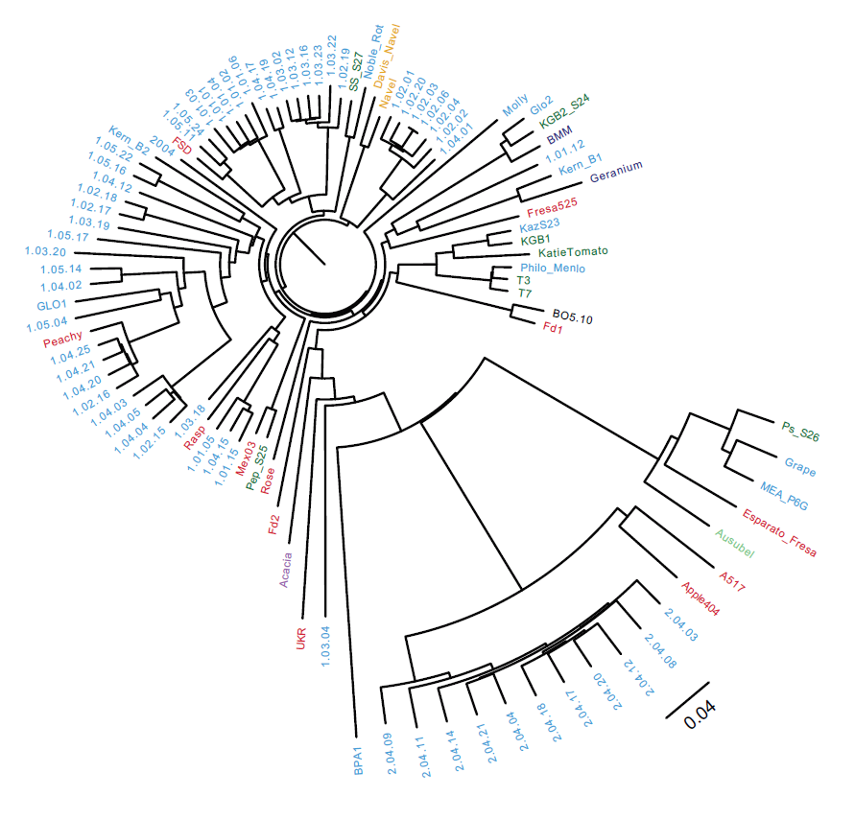
Genetic Diversity Within Botrytis
96 genotypes
WGS
3% polymorphism
NJ tree (nuclear + mt)
No significance!
Atwell et al. in prep
Notes:
98 Botrytis isolates, color coded by plant host species from which they were isolated
Unrooted Neighbor-joining phylogenetic tree of pairwise SNP differences aligned to the T4 reference
Slight clustering of isolates within the tree
the 11 isolates sampled within one grape field are very closely related
highest recorded level of standing genetic variation within plant pathogens – generalism?
The broad host range is likely facilitated by recombination amongst highly polymorphic genes within a massive population
“a panglobal fungus with high connectivity and admixture rather than barriers and population isolation.”
QUANT virulence and quant resistance- heather pg paper. Specialization – specific virulence genes specialize, isolates don’t specialize
~gymnosperm
ADD PICTURES

Slide 15
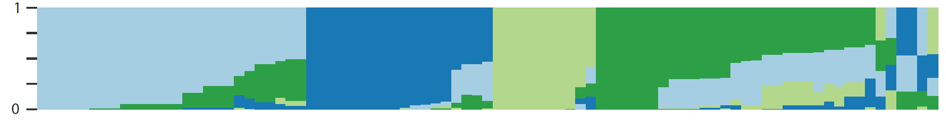
Admixture Between Botrytis Sub-Populations
STRUCTURE and CLUMPP analysis, K=4
Atwell et al. in prep
Notes:
STRUCTURE and CLUMPP (Jakobsson and Rosenberg 2007; Pritchard, Stephens, and Donnelly 2000) results, K=4 (the smallest stable K value represents the optimum value) was the best clustering solution of the 87 isolates (Figure 2D). 41 isolates were placed in distinct clusters (made up of 19, 9, 5 and 8 isolates) with the remaining 46 isolates being admixtures of 2-4 of these clusters. Further, half of these isolates represent admixtures of these four theorized populations, which increases the potential utility of genome wide association mapping.

Slide 16
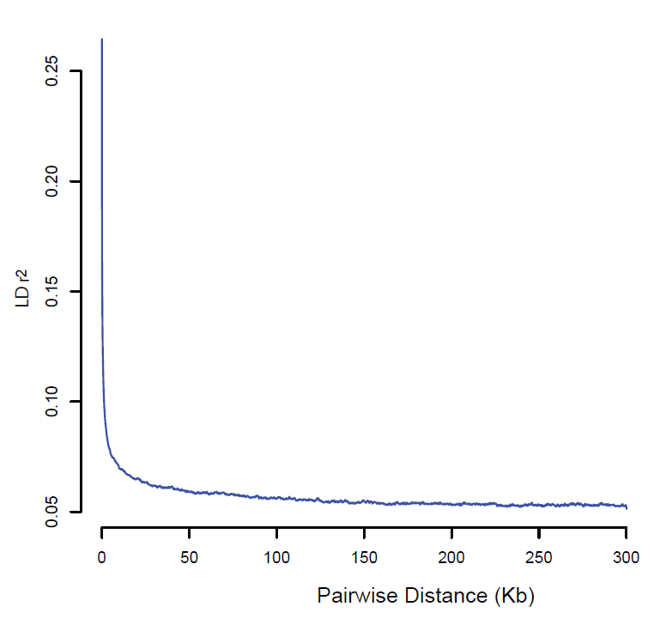
Evidence of Outcrossing and Recombination
Atwell et al. in prep
Notes:
LD decayed rapidly and mean r2 across the genome fell to approximately one-half of the initial value within 1 kb (Figure 3A). This further supported the presence of relatively frequent outcrossing and recombination within this species.

Slide 17
Predictions for an Extreme Generalist
“Silver Bullet” Virulence Gene
Diversity low to moderate, no specialization
Isolate Specialization
Diversity moderate to high, high population structure
Allele Specialization
High diversity, allele mixing for isolate diversity

Slide 18
How Does Botrytis Genetic Variation Alter Virulence on Diverse Hosts?
Genetics underlying virulence phenotypes
Contributions of host and pathogen genetics to lesion size variation
Pathogen genomics of lesion size on domesticated plant hosts
Pathogen genomics associated with plant domestication
Genetics underlying expression variation
Variation in host and pathogen gene expression during infection
Pathogen genomics of pathogen expression variation
Pathogen genomics of plant expression variation

Slide 19
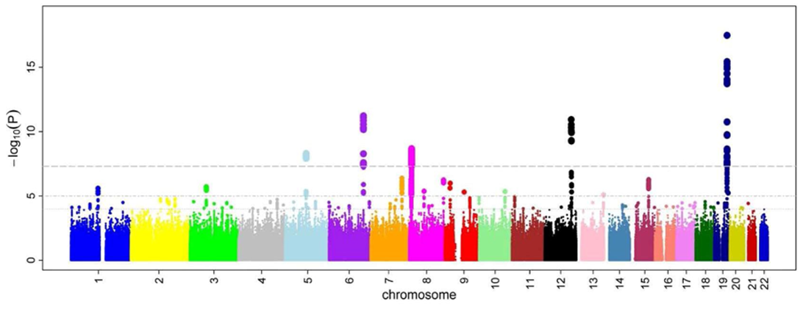
What Do We Need for GWAS in Botrytis?
Genetic Variation
Recombination
Low linkage disequilibrium
No clonality

Slide 20
Genetics Underlying Virulence Phenotypes:
Botrytis Lesion Size on Domesticated and Wild Tomato

Slide 21
Main Questions
How does genetic diversity in B. cinerea facilitate infection of such a wide host range?
What are the conserved and variable mechanisms of plant defense to a necrotrophic pathogen?
How does domestication affect the host interaction with a common necrotroph?
Notes:
ADD PICTURES

Slide 22
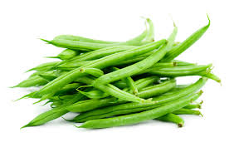

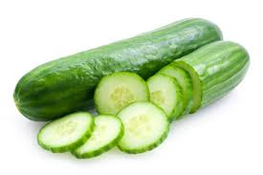
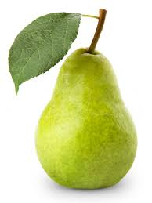
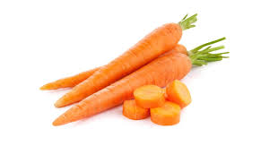


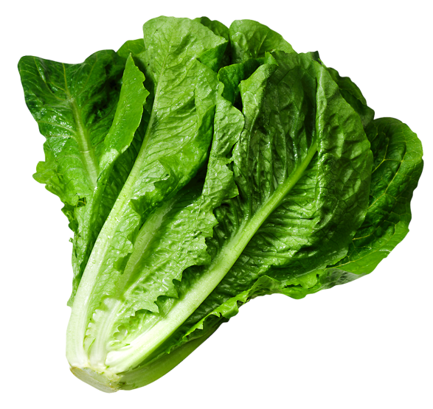



Domesticated Eudicots
Botrytis Hosts

Slide 23
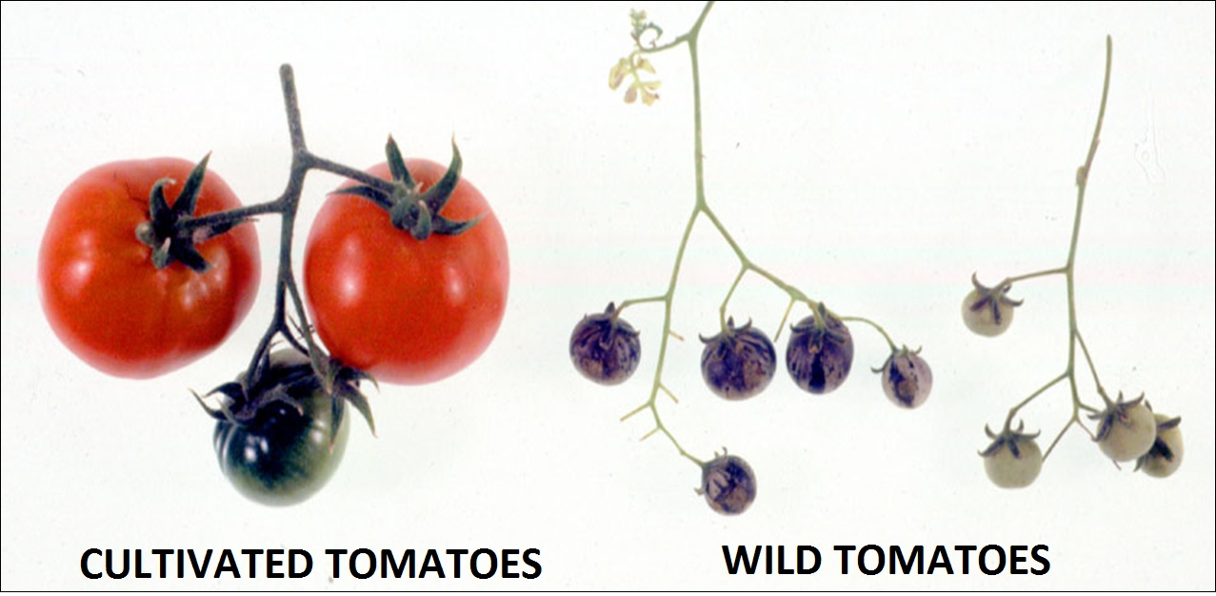
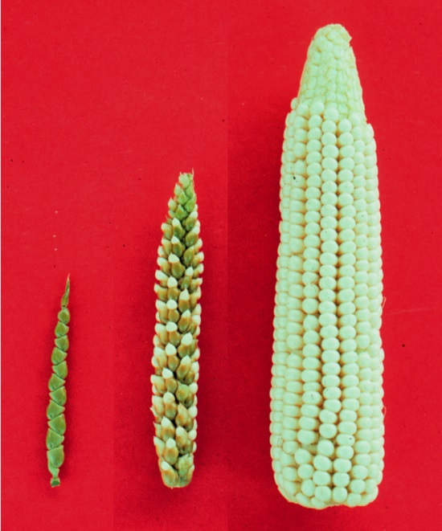
Classic Patterns of Plant Domestication
Assume: Same general consequences of each plant domestication
Assume: Reduced pathogen defense in domesticated hosts
Gardening Stack Exchange
Genetics-gsa.org

Slide 24
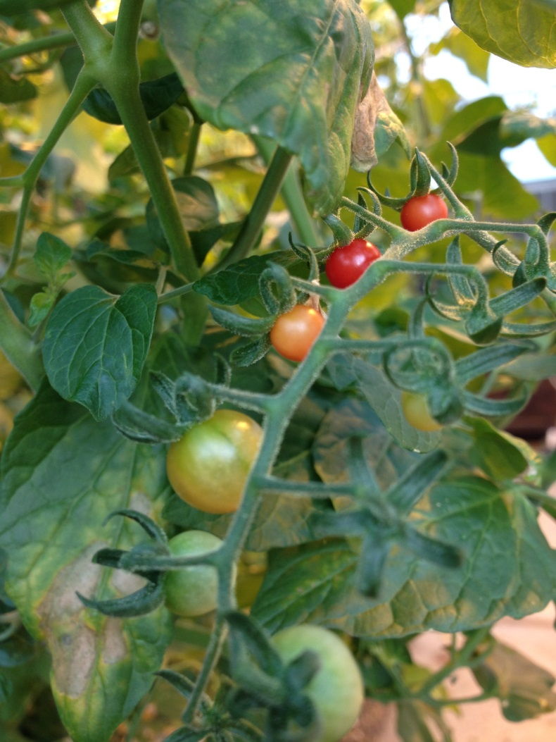
Focal Host: Tomato
Botrytis crop loss: pre- and post-harvest infestation
Quantitative resistance to Botrytis
In domesticated tomato
QTL found explain ≤ 15% of phenotype (Finkers 2007)
And in wild tomato (S. pimpinellifolium)

Slide 25
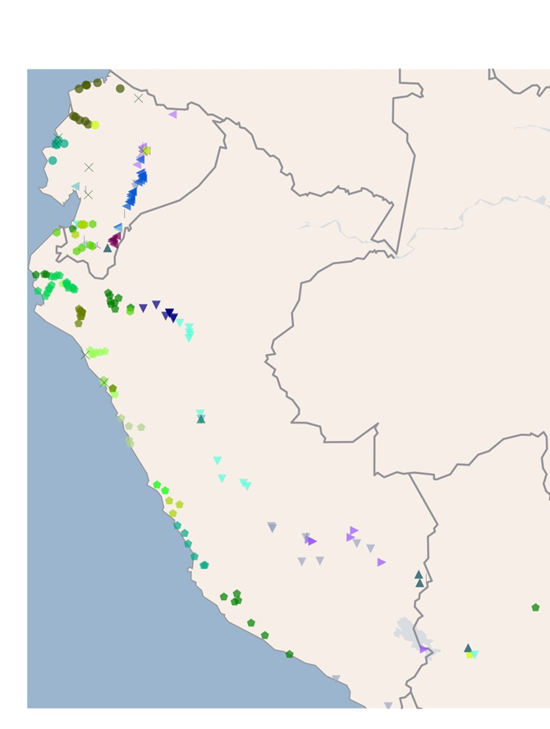
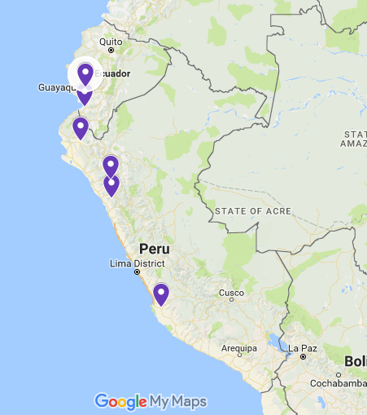
Selected Tomato Accessions
Blanca 2015 BMC Genomics

Slide 26
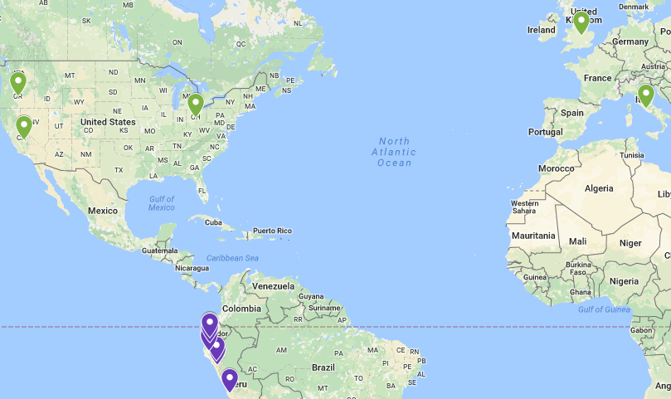
Selected Tomato Accessions
Blanca 2015 BMC Genomics

Slide 27
Selected Tomato Accessions
Species | TGRC label | Approx. origin | Varietal name
Solanum lycopersicum | LA0410 | Guayaquil Mercado, Guayas, Ecuador
 | LA4355 | Oregon, USA | Gold Nugget
 | LA2706 | England | Moneymaker
 | LA4345 | Ohio, USA | Heinz 1706
 | LA3475 | California, USA | M-82
 | LA3008 | Italy | San Marzano
Solanum pimpinellifolium | LA0480 | Hacienda Santa Inez, Ica, Perú
 | LA1589 | La Libertad, Peru
 | LA2176 | Timbaruca, Peru
 | LA1684 | Chulucanas, Peru
 | LA2093 | El Oro, Ecuador
 | LA1547 | Carchi, Ecuador

Slide 28
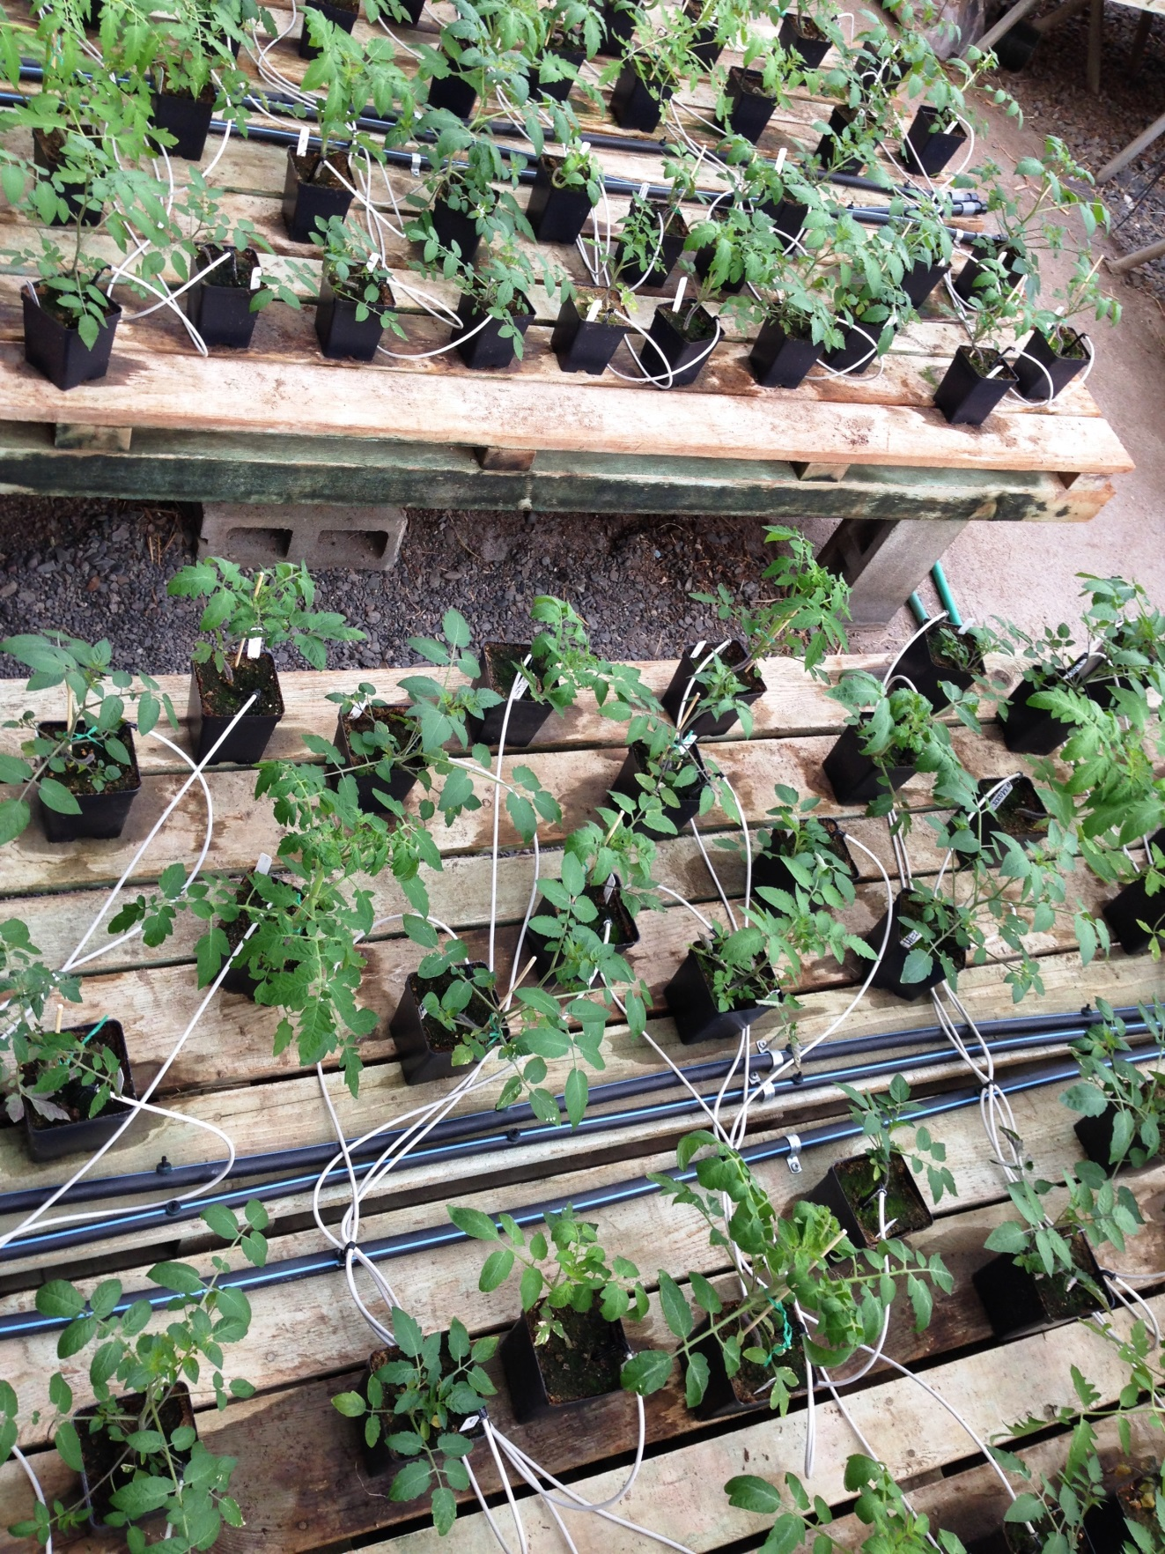

Experimental Design
Wild and Domestic hosts x
6 plant genotypes each x
92 Botrytis isolates x
3 replicates x
2 independent experiments
6,624 lesions

Slide 29
Digital Imaging of Detached Leaves

Slide 30
Digital Imaging of Detached Leaves

Slide 31
Digital Imaging of Detached Leaves

Slide 32
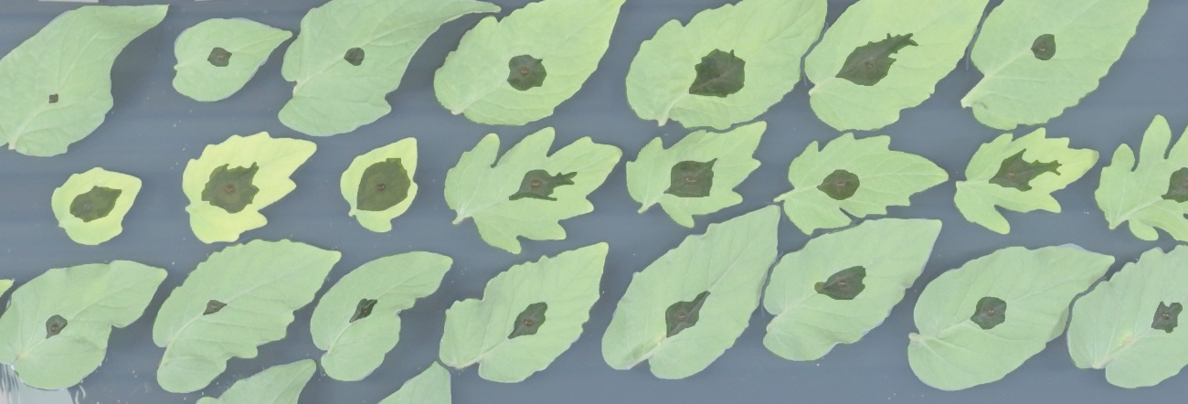
Digital Phenotyping

Slide 33
Genetic Diversity Within Botrytis
96 genotypes
WGS
3% polymorphism
NJ tree (nuclear + mt)
No significance!
Atwell et al. in prep
Notes:
98 Botrytis isolates, color coded by plant host species from which they were isolated
Unrooted Neighbor-joining phylogenetic tree of pairwise SNP differences aligned to the T4 reference
Slight clustering of isolates within the tree
the 11 isolates sampled within one grape field are very closely related
highest recorded level of standing genetic variation within plant pathogens – generalism?
The broad host range is likely facilitated by recombination amongst highly polymorphic genes within a massive population
“a panglobal fungus with high connectivity and admixture rather than barriers and population isolation.”
QUANT virulence and quant resistance- heather pg paper. Specialization – specific virulence genes specialize, isolates don’t specialize
~gymnosperm
ADD PICTURES

Slide 34
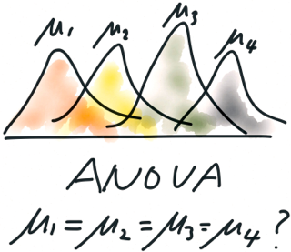

Plant or Pathogen Importance?
What controls the variance across ~ 6,500 lesions?
Plant Genotype
Botrytis genotype
Domestication status
Interactions
Experiment
Used a Linear model:
Lesion = Isolate + Domest + Do/Plant
+ Iso*Do + Iso*Do/Plant
+ Experiment + Exp/Block
+ Exp*Iso + Exp*Do + Exp*Do/Plant

Slide 35
Plant or Pathogen Importance?
What controls the
variance across ~ 6,500 lesions?
Plant Genotype
Botrytis Genotype
Domestication status
Interactions
Experiment
What controls the
variance across ~ 6,500 lesions?
Plant Genotype p<2e-16
Botrytis Genotype p<2e-16
Domestication status p<2e-16
Interactions: Exp*Botry, Exp*Dom, Exp*Plant
Experiment p<2e-16

Slide 36
Domestication Influences Lesion Size… Slightly

Slide 37
Variation Within Domestication Is Greater than Between

Slide 38
What Can We Learn By Looking at the Isolates?
All isolates

Slide 39
Reference B05.10 Isolate Is Middling
B05.10

Slide 40
No Host Specificity – Isolates From Tomato Are Not Most Virulent
Tomato isolates

Slide 41
Are Certain Isolates More Sensitive to the Host?
Ask which isolates are more sensitive to
Genetic variation between wild and domestic tomato
Genetic variation within wild or domestic tomato
Run models on individual isolates:
Lesion = Species + Sp/Plant + Experiment
False discovery rate adjustment

Slide 42
Isolates Sensitive to Variation Between W/D
Domestication sensitive isolates

Slide 43
Isolates Sensitive to Variation Within W/D
Host-sensitive isolates

Slide 44
Genetics of Host-Isolate Interaction
What Botrytis genes control this diversity?
Strategy: use Botrytis genetic variation to find candidate genes in pathogen
Then, ask which genes in plant control interaction
Especially for non-model hosts
E.g. chitin synthase in Botrytis → chitinase in plant

Slide 45
GWAS: bigRR
Botrytis genome ~ 39 Mb
92 Botrytis isolates
345k SNPs at MAF20
Thresholds: permute phenotype data 1000x
95%
99%
99.9%

Slide 46
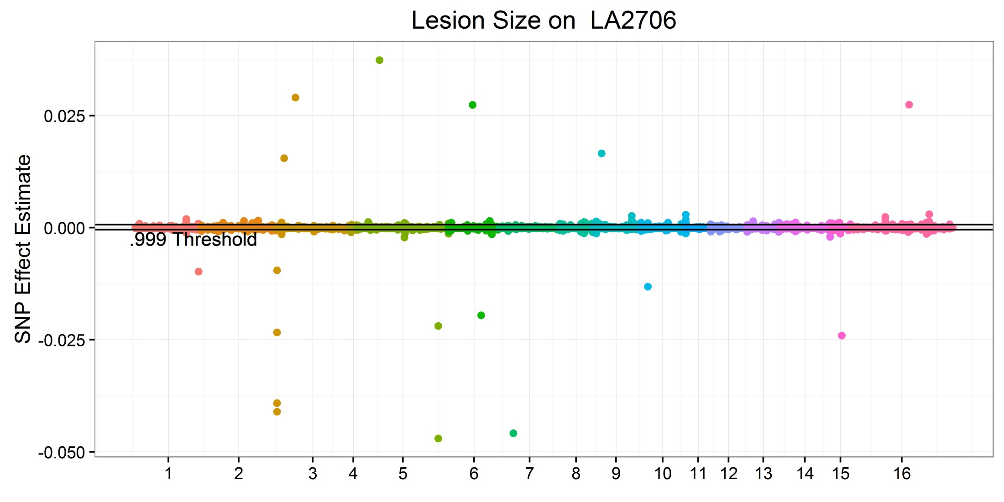
GWAS: Lesion Size in Botrytis on a Single Tomato Genotype

Slide 47
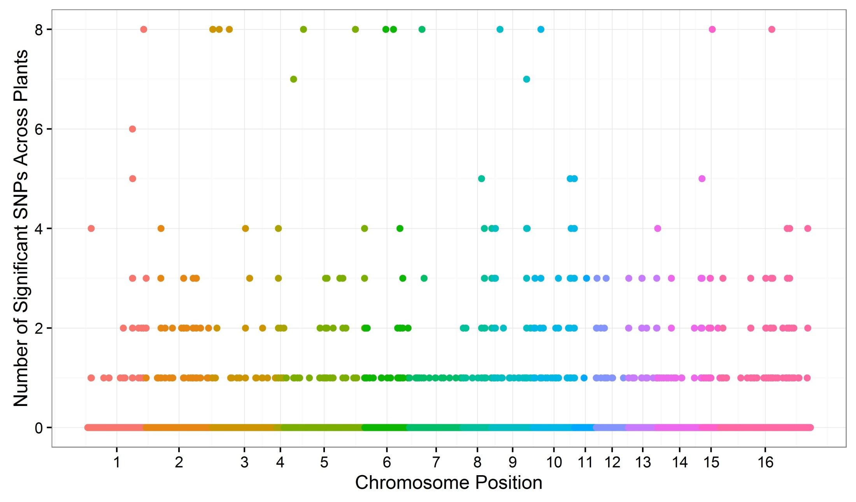
How Common are Significant Loci Across 12 Tomato Hosts?

Slide 48

Which Botrytis Loci Have Large Effects on Multiple Plant Hosts?

Slide 49
Which Botrytis Genes Have Large Effect SNPs on Multiple Plant Hosts?
Plants | Chrom. | Gene | Annotation
5 | 1 | BcT4_837 | unknown
8 | 3 | BcT4_10065 | unknown
5 | 3 | BcT4_4120 | SNF5 / SMARCB1 / INI1
8 | 3 | BcT4_4284 | Glycosyl hydrolase family 65
8 | 5 | BcT4_1123 | Fungal specific transcription factor domain
8 | 5 | BcT4_3023 | NACHT domain
3 | 6 | BcT4_3437 | YjeF-related protein N-terminus
7 | 6 | BcT4_3552 | GlcNAc-PI de-N-acetylase
7 | 7 | BcT4_6249 | GDP/GTP exchange factor Sec2p
8 | 9 | BcT4_2094 | unknown
3 | 10 | BcT4_1557 | bZIP transcription factor
5 | 15 | BcT4_9049 | GAT domain
7 | 16 | BcT4_9392 | Ankyrin repeats (many copies)

Slide 50

How Many Botrytis Candidate Genes are Identified on Multiple Plant Genotypes?
Plant Genotypes with Significant SNPs

Slide 51
What Enabled Botrytis to Respond to Tomato Domestication?
Comparison of Botrytis virulence on Domesticated vs. Wild tomato
(D-W)/D
“Domestication Sensitivity”

Slide 52


No Evidence for “True” Domestication-Responsive Loci
Domestication Sensitivity

Slide 53

Sensitivity Phenotype Suggests Unique SNPs from Domesticated or Wild
Domestication S
Power to detect issue?

Slide 54

But, More Overlap at Gene Level
Domestication Sensitivity

Slide 55
Example Genes
Significant SNPs depend on phenotype tested
BcT4_10004
NACHT domain
10 sig. SNPs from 4kb to 16kb on Chr. 2.3
1 sig. SNP shared between Domesticated and Wild
BcT4_10099
SNF2 family N-terminal domain
5 sig. SNPs from 0kb to 13kb on Chr. 6.1
1 sig. SNP shared between Domesticated and Wild

Slide 56

Example Genes: BcT4_10004

Slide 57

Example Genes: BcT4_10099

Slide 58

So What Did Domestication Do to the Pathogen?
Analysis within Domestication

Slide 59

So What Did Domestication Do to the Pathogen?
Analysis within Domestication

Slide 60
So What Did Domestication Do to the Pathogen?
~ 200 Botrytis genes have variation that seems sensitive to tomato domestication
Mostly metabolism: 50 enzymes
Fungal-specific TFs: 6
Only one pathogenesis-related
CFEM domain (fungal extracellular membrane)

Slide 61
So What Did Domestication Do to the Pathogen?
Mostly metabolism: 50 enzymes
Ergot alkaloid biosynthesis
Cyt p450 oxidoreductases
Toxin production/ detox plant compounds?

Slide 62
Tomato Summary
Domesticated tomato is slightly more susceptible
No evidence for reduced diversity in defense genes due to domestication
Pathogen genotype effect > plant genotype
No true saprophytes or hypervirulent isolates
Pathogen virulence is as polygenic as host resistance

Slide 63
eQTL introduction

Slide 64

Genetic control of gene expression
MacLellan et al. 2012, Nature

Slide 65
eQTL in pathogens
(human pathogen examples?)

Slide 66
Biology of transcriptome x transcriptome interactions

Slide 67

Cross-species eQTL: symbiosis of Medicago truncatula and parasitic nematode
Guo et al. 2017, Genetics

Slide 68
Methods

Slide 69


RNAseq
95 Botrytis isolates
On Arabidopsis Col-0
(and coi-1, npr-1)
Detached leaf assay, 16 hpi
x
Notes:
Draw Bc cartoon as hyphal cluster (microscope image)
Here, show an actual photo of At and Bc (micro!)

Slide 70
GEMMA for eQTL
271,495 SNPs against the Botrytis B05.10 genome
MAF > 0.20
<20% missingness
For each of:
9267 Botrytis gene expression phenotypes
23,948 Arabidopsis gene expression phenotypes
Notes:
SNP density? Per Mb // LD – include some
Heterozygosity levels ~~ none

Slide 71
Previous Results

Slide 72

Botrytis gene expression is controlled by pathogen & host genetics
0.0 0.1 0.2 0.3 0.4
B. cinerea Transcript Heritability Distribution
Isolate Host Genotype Isolate x Host Genotype
Zhang et al. unpublished
Notes:
Host genotypes change (knockout) major defense pathways (major effects), but they are not driving the system. PATHOGEN TOO!

Slide 73

Botrytis genetic control of gene expression
Zhang et al. unpublished
Notes:
Expression profile of B. cinerea transcripts significantly influenced by host genotypes. Gene counts per transcript are normalized relative expression (log₂).
we found that the host immune system was able to alter the expression of only some of the pathogens GCNs
-- those that shift in expression depending on host genotype
natural variation in the pathogen shapes how the co-transcriptome responds to the hosts immune system.

Slide 74

Arabidopsis gene expression is controlled by pathogen & host genetics
Zhang et al. 2017, The Plant Cell

Slide 75

Botrytis genetic control of Arabidopsis gene expression
Zhang et al. 2017, The Plant Cell
Notes:
Plasticity in Arabidopsis defense related genes in response to B. cinerea genetic variation.
Pr1 = SA responsive
Pad3 = camalexin biosynth
PDF = JA response

Slide 76
Novel Results

Slide 77
GEMMA of expression profiles
Notes:
1-gene GWAS
Show selecting top SNP hit. Diagram cartoon?

Slide 78

Search for cis-eQTL patterns

Slide 79
Lack of genome-wide cis-eQTL enrichment
Notes:
NOT “no cis-diag”
YES “our analysis failing to capture cis-diag”

Slide 80
Lack of observed cis effects:
Are there no major cis-effect loci for B. cinerea gene expression?
Or, did our analysis miss these cis-effects?

Slide 81


Search for cis-eQTL: Botcynic acid biosynthetic cluster
BcBOA6
0 1 2 3 4
Expression (log₂)
Notes:
Add a top panel: Vivian 2018 figure 5e. BOA transcriptional profile. Large fx: expect cis fx variation!
Expression Profiles of B. cinerea Transcripts Encoding Botrydial Varied Across 96 Isolates And Positively Correlated with Lesion Area
Bar plots compare expression variation of BcBOA6 transcript from botcinic acid (BOA) pathway and Bcin01g11460.1 transcript from cyclic peptide pathway across 96 B. cinerea isolates. Gene counts per transcript are normalized expression (log₂)

Slide 82

Search for cis-eQTL: Botcynic acid biosynthetic cluster
1
2
3
4
5
6
Notes:
DO NOT say “group 4 not significant”
DO SAY “massive group 5, from which group 4 outliers

Slide 83

Most expression variation in BOA cluster not explained by cis-eQTL
Notes:
SNPs ~ dimodal model // GWA model “2 groups”
BUT variation splits into 6 haplotypes at this locus – true model “6 haplotypes”
DO ADD group 5, 6: low outliers. Change in expression with haplotypes other than the group 4 deletion
→ Poly haplotypery!

Slide 84
cis-acting loci may not be captured by SNP genotypes
78.6kb deletion, group 4

Slide 85
Lack of genome-wide cis-eQTL enrichment
Notes:
Evidence of trans hotspots…

Slide 86

Search for eQTL hotspots: Botrytis

Slide 87

Cross-species eQTL hotspots

Slide 88
Are hotspots significant? Permuation approach
Randomized each expression profile (phenotype) 5x
For Botrytis genes
For Arabidopsis genes
Calculated minimum SNP p-value per gene for all 5 permutations
Take permutation minimum
Is minimum p-value of actual gene < random phenotype?
Is 5x permutation sufficient?
1000x permutation of 10 randomly selected gene expression phenotypes
Notes:
we are working on permutation approaches to test what is or is not a significant hotspot

Slide 89
Are hotspots significant? Simulated GEMMA approach
Random draws from genome = 271,495 SNPs
For each of:
9267 Botrytis gene expression phenotypes
23,948 Arabidopsis gene expression phenotypes
Repeat 1000x

Slide 90

Botrytis eQTL hotspots > simulation threshold
Notes:
Threshold: from 1000 replicates of simulated random GEMMA, at max hotspot size = 4

Slide 91
Transition…
Fungal DNA → fungal transcription variation
Fungal DNA → plant transcription variation?

Slide 92

Arabidopsis eQTL hotspots > simulation threshold
Notes:
Threshold: from 1000 replicates of simulated random GEMMA, at max hotspot size = 5

Slide 93

eQTL hotspot overlap: Arabidopsis and Botrytis
Notes:
Ellipse: joint species hotspot
Log-log to see center hotspots

Slide 94

eQTL hotspot overlap: Arabidopsis and Botrytis
Notes:
ADD HERE: SNPs of interest annotated
THEN zoom in BOA
Plot manhattan BOA cluster: chunk of hotspots in cluster?

Slide 95

Selected genes at Botrytis eQTL hotspots
SNF2-related, helicase
BcBOA7: Botcynic acid biosynthesis
Cys6: transcription factor
Cytochrome p450
HHK5: signal transduction

Slide 96

Selected genes at Arabidopsis eQTL hotspots
Heterokaryon incompatibility
NACHT
BcBOA7: Botcynic acid biosynthesis

Slide 97
BcBOA7 eQTL hotspot
BcBOA7: Botcynic acid biosynthesis

Slide 98
BcBOA7 eQTL hotspot: putative targets
Botrytis genes
Arabidopsis genes
13 linked
Bcin09g02390 (Bmp3): MAPK
Bcin15g01380: succinyl coA synthetase
62 linked
AT3G43440.1: jasmonate zim domain protein 11
AT1G08010: zinc finger TF
AT5G59460.1 (SCL11): scarecrow like TF
Notes:
Mitogen activated protein kinase: fungal virulence
Bmp3: plant surface sensing, KO decreases virulence
JAZ11: downstream jasmonate response
AT1G0810: slight Bc inducible
SCL11: not much B05.10
CONNECT to virulence. These are defense genes

Slide 99

Linear model for transcript profiles
Y_{egai} = E_{e} + E_{e}(Gf_{g}) + E_{e}(Gf_{g}(Af_{a})) + I_{i} + H_{h} + H_{h}* I_{i}
Zhang et al. 2017, The Plant Cell

Slide 100


Acknowledgements
Kliebenstein Lab
Dr. Susanna Atwell
Dr. Celine Caseys
Dr. Ella Katz
Michelle Tang
Former Lab Members
Dr. Baohua Li
Dr. Jason Corwin
Dr. Gongjun Shi
Dr. Wei Zhang
Rachel Fordyce
Raoni Gwinner
Undergraduates
Dihan Gao
Aysha Shafi
Dick Leon
Ayla Nelson
David Kelly
Matisse Madrone
Josue Vega
Melissa Wang
Jastro Shields
Research Award

Slide 101
Search terms
Genetical genomics
Malaria for eQTL?
Tyler and colleagues (B. Tyler, personal communication; http://soy.vbi.vt.edu) have used the soybean/P. sojae/H. glycines Affymetrix GeneChip containing probes for both the host and pathogen to examine the interaction in eight soybean cultivars with varying levels of quantitative resistance. F

